Slide 1
Test Overview-Grade 3&4
Day 1 | Day 2
4 reading passages 24 multiple choice questions Reading Standards | 3 reading passages 0 multiple choice questions 6 short answer questions Reading Standards 1 extended response question Grade 3-1 Text Grade 4-2 Texts Writing Standards
Untimed (suggested 60-70 minutes) | Untimed (suggested 70-80 minutes)

Slide 2
Test Overview Grade 5
Day 1 | Day 2
5 reading passages 35 multiple choice questions Reading Standards | 3 reading passages 0 multiple choice questions 6 short response questions Reading Standards 1 extended response-2 Texts Writing Standards
Untimed (suggested 80-90 minutes) | Untimed (suggested 70-80 minutes)

Slide 3
Reading Genres
Literary | Informational
Fiction Realistic Historical Folktale Fable Myth Letter Play Non-Fiction Biography Autobiography NF story Memoir Personal Narrative | Procedural All About Interview Expository with titles, subtitles and without Argumentative Opinion Letters Letter Speech Advertisement Op Ed Feature articles

Slide 4
Test Design
Concepts | Percentage of Test
Key Ideas and Details (Standards 1, 2, 3) | Up to 65%
Craft and Structure (Standards 4, 5, 6) | Up to 35%
Integration of Knowledge and Ideas (Standards 7, 8, 9) | Up to 30%

Slide 5
Preparing for a Test
Reading
Assessment Based
Transfer and apply learning from previous units
Maneuver through the test
Revisit reading literary and informational texts
Week of reading mixed genres
Targeted small group instruction based on assessment

Slide 6
Preparing for a Test
Writing
Short response
Reading and interpreting, making decisions about how to frame extended response questions
Drafting and revising extended response questions using rubrics and checklists

Slide 7
Scoring the Test
Multiple Choice
Grades 3&4: 24 questions
Grade 5: 35 questions
Short Answer
Grades 3, 4, 5: 6 questions @ 2 points each
Extended Response
Grades 3, 4, 5: 1 questions @ 4 points

Slide 11
Extended Response

Slide 15
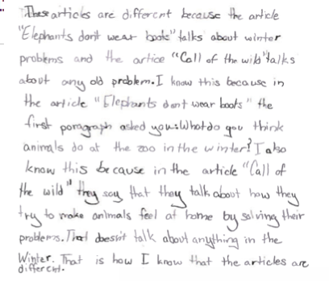

Slide 16
What can I do at home?
Read often
Many genres
Read short passages from magazines
Answer the question being asked
Longer stretches of time
Flexible Problem solving
Good night sleep
Eat breakfast
Keep children calm
Do not
Allow kids repeated practice making mistakes
Read test or test prep passages over and over and answer questions

